Slide 1



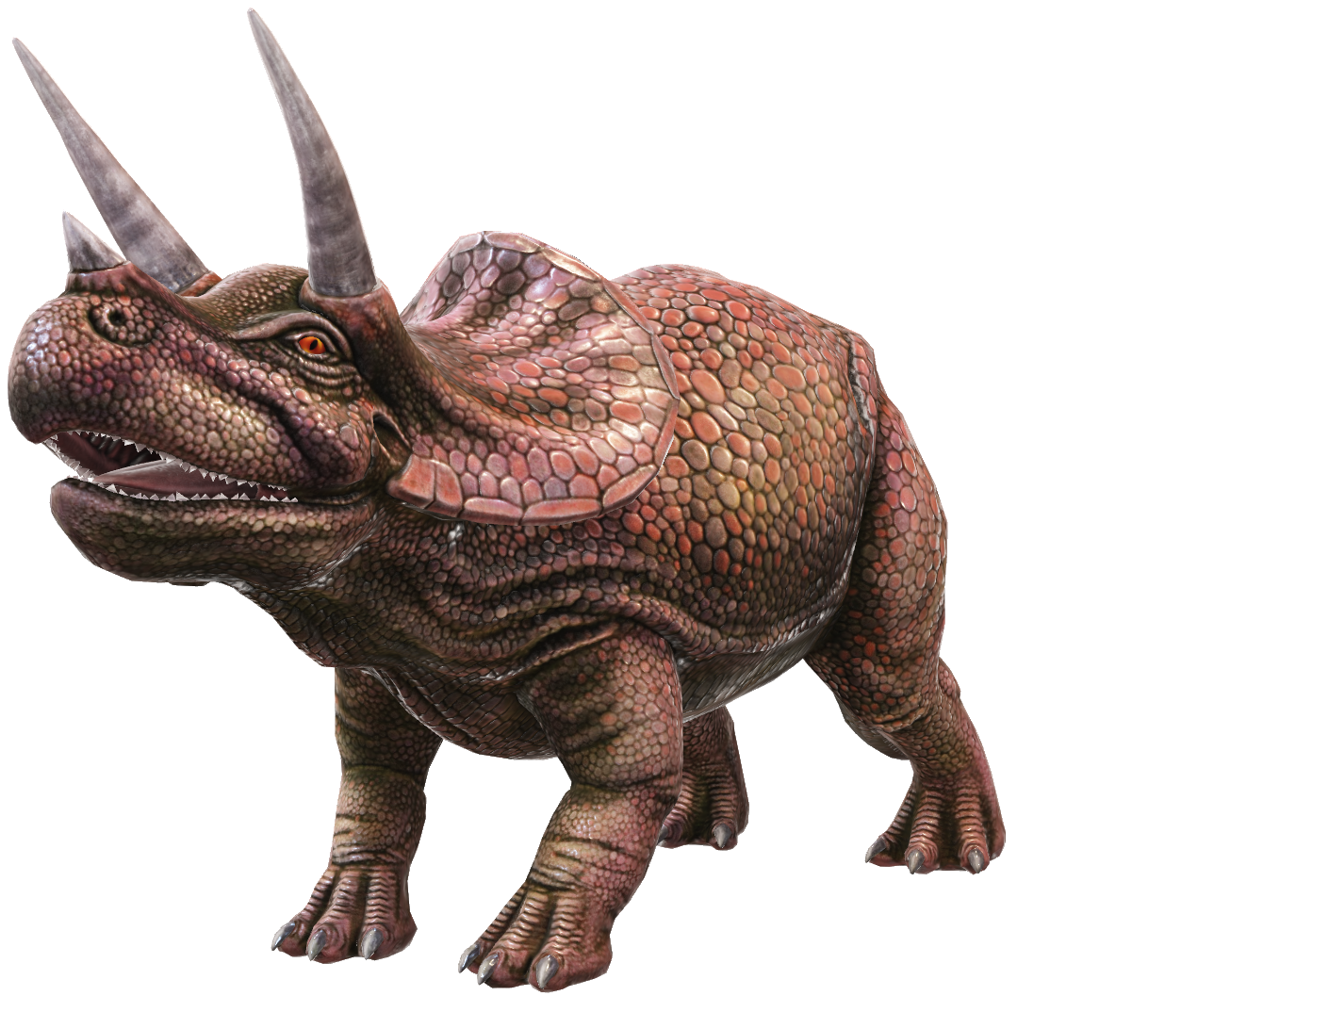
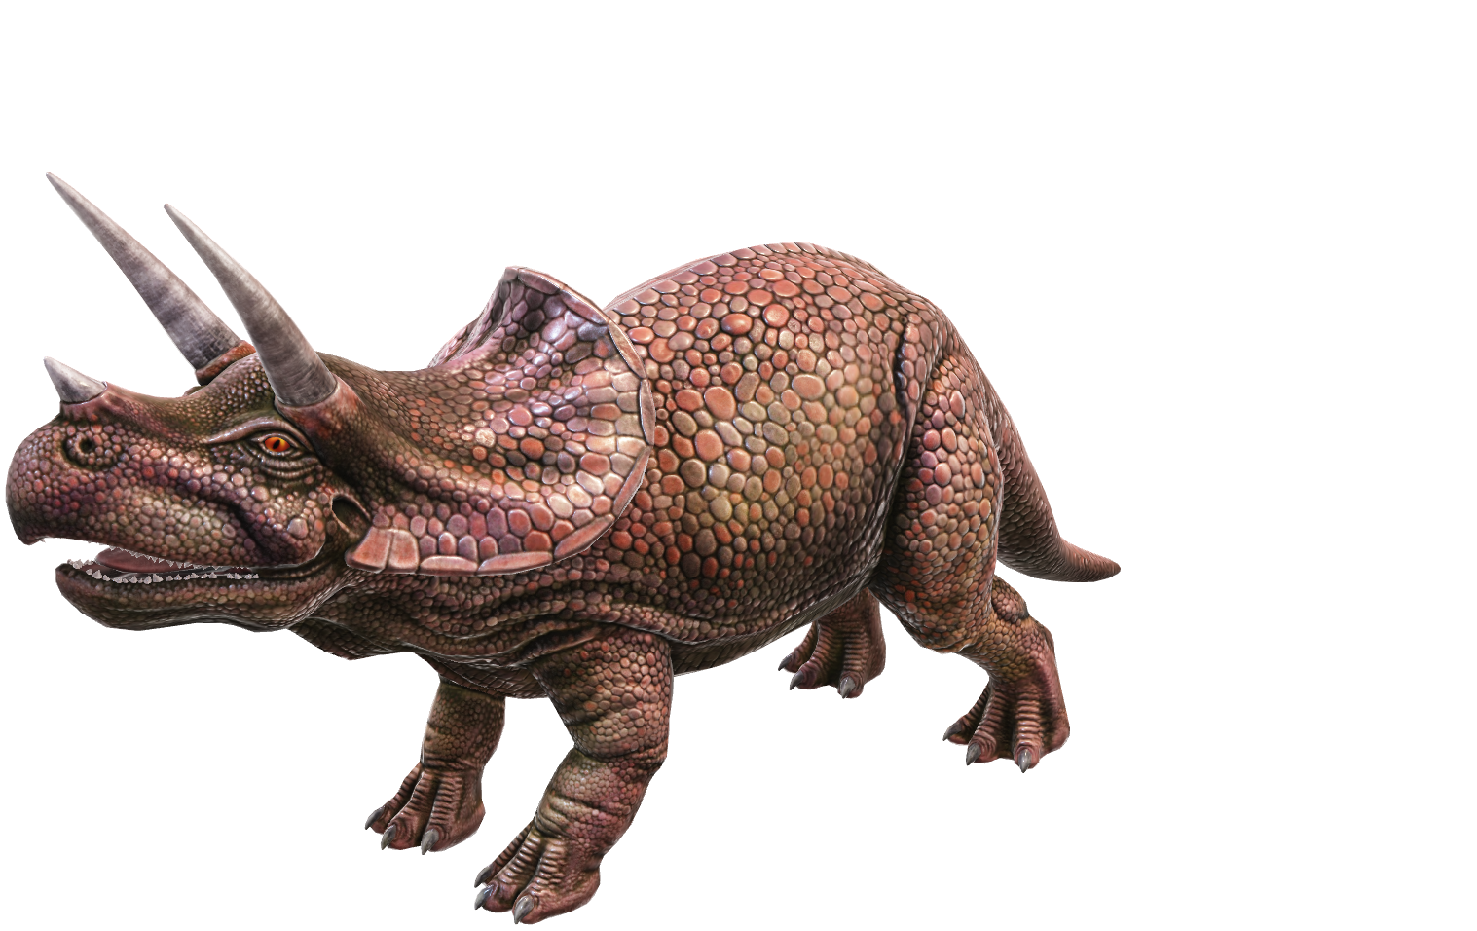
History of Dinosaurs

Slide 2





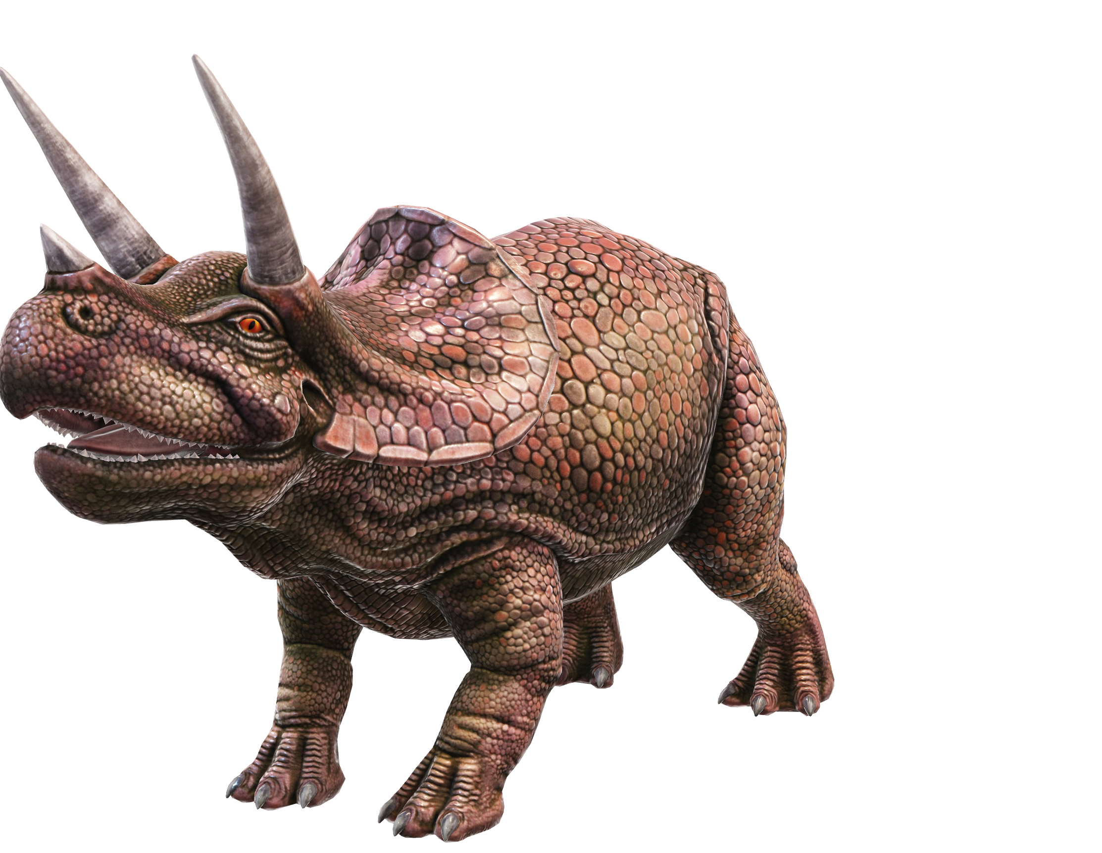
All about Dinosaur
The Name Dinosaur
The name dinosaur comes from the term Dinosauria, which means terrible lizards.
Size of Dinosaur
Largest dinosaurs are over 30 meters long and 15 meters tall
Smallest dinosaurs are about size of chicken.
Reptiles
Dinosaurs are reptiles and most hatched from eggs

Slide 3
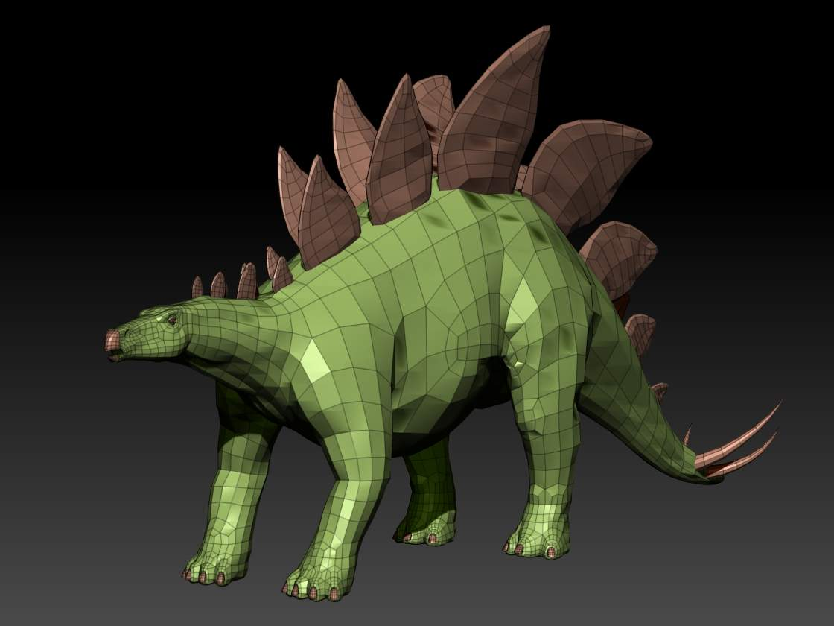
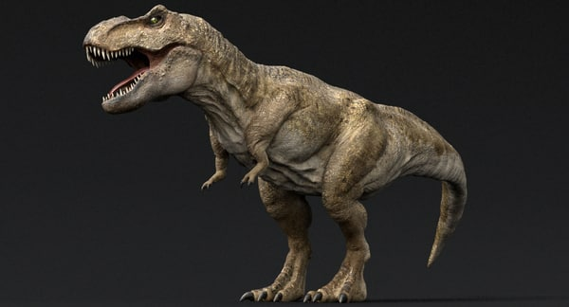
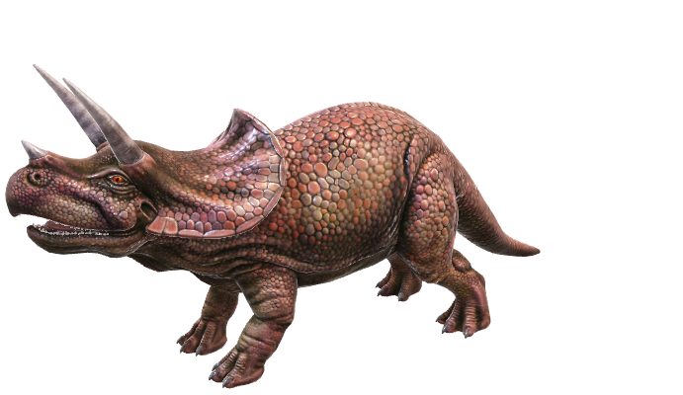
Types of Dinosaurs
Dinosaurs can be classified into 2 groups by looking at their hip structure
Dinosaur
Lizard Hipped Dinosaurs(Saurischia) – Lizard shape
Bird hipped dinosaurs(Ornithiscia) – Bird shaped dinosaurs
Theropods – They have beast foot and walk on two legs. Meat eaters(Carnivores)
Thyrepora – They have shield shape on the body.
Sauropods – They walk on 4 legs and these are plant eaters(Herbivores).
Cerapods – Horn faced dinosaurs

Slide 4
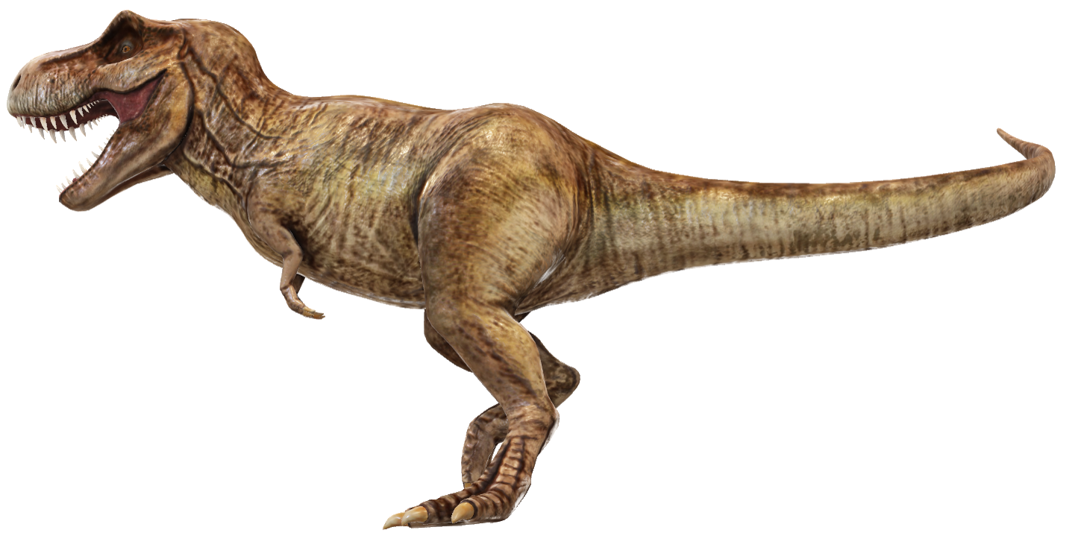
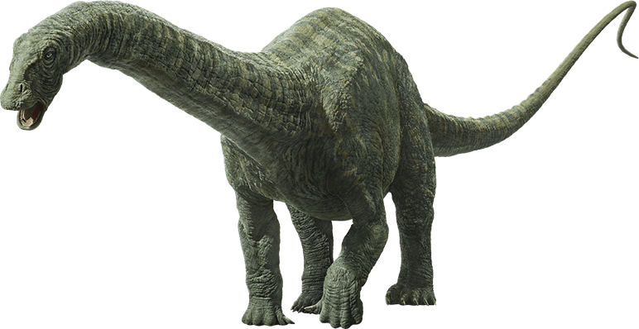
Dinosaur – Food Chain
Secondary Consumer
Primary Consumer

Slide 5
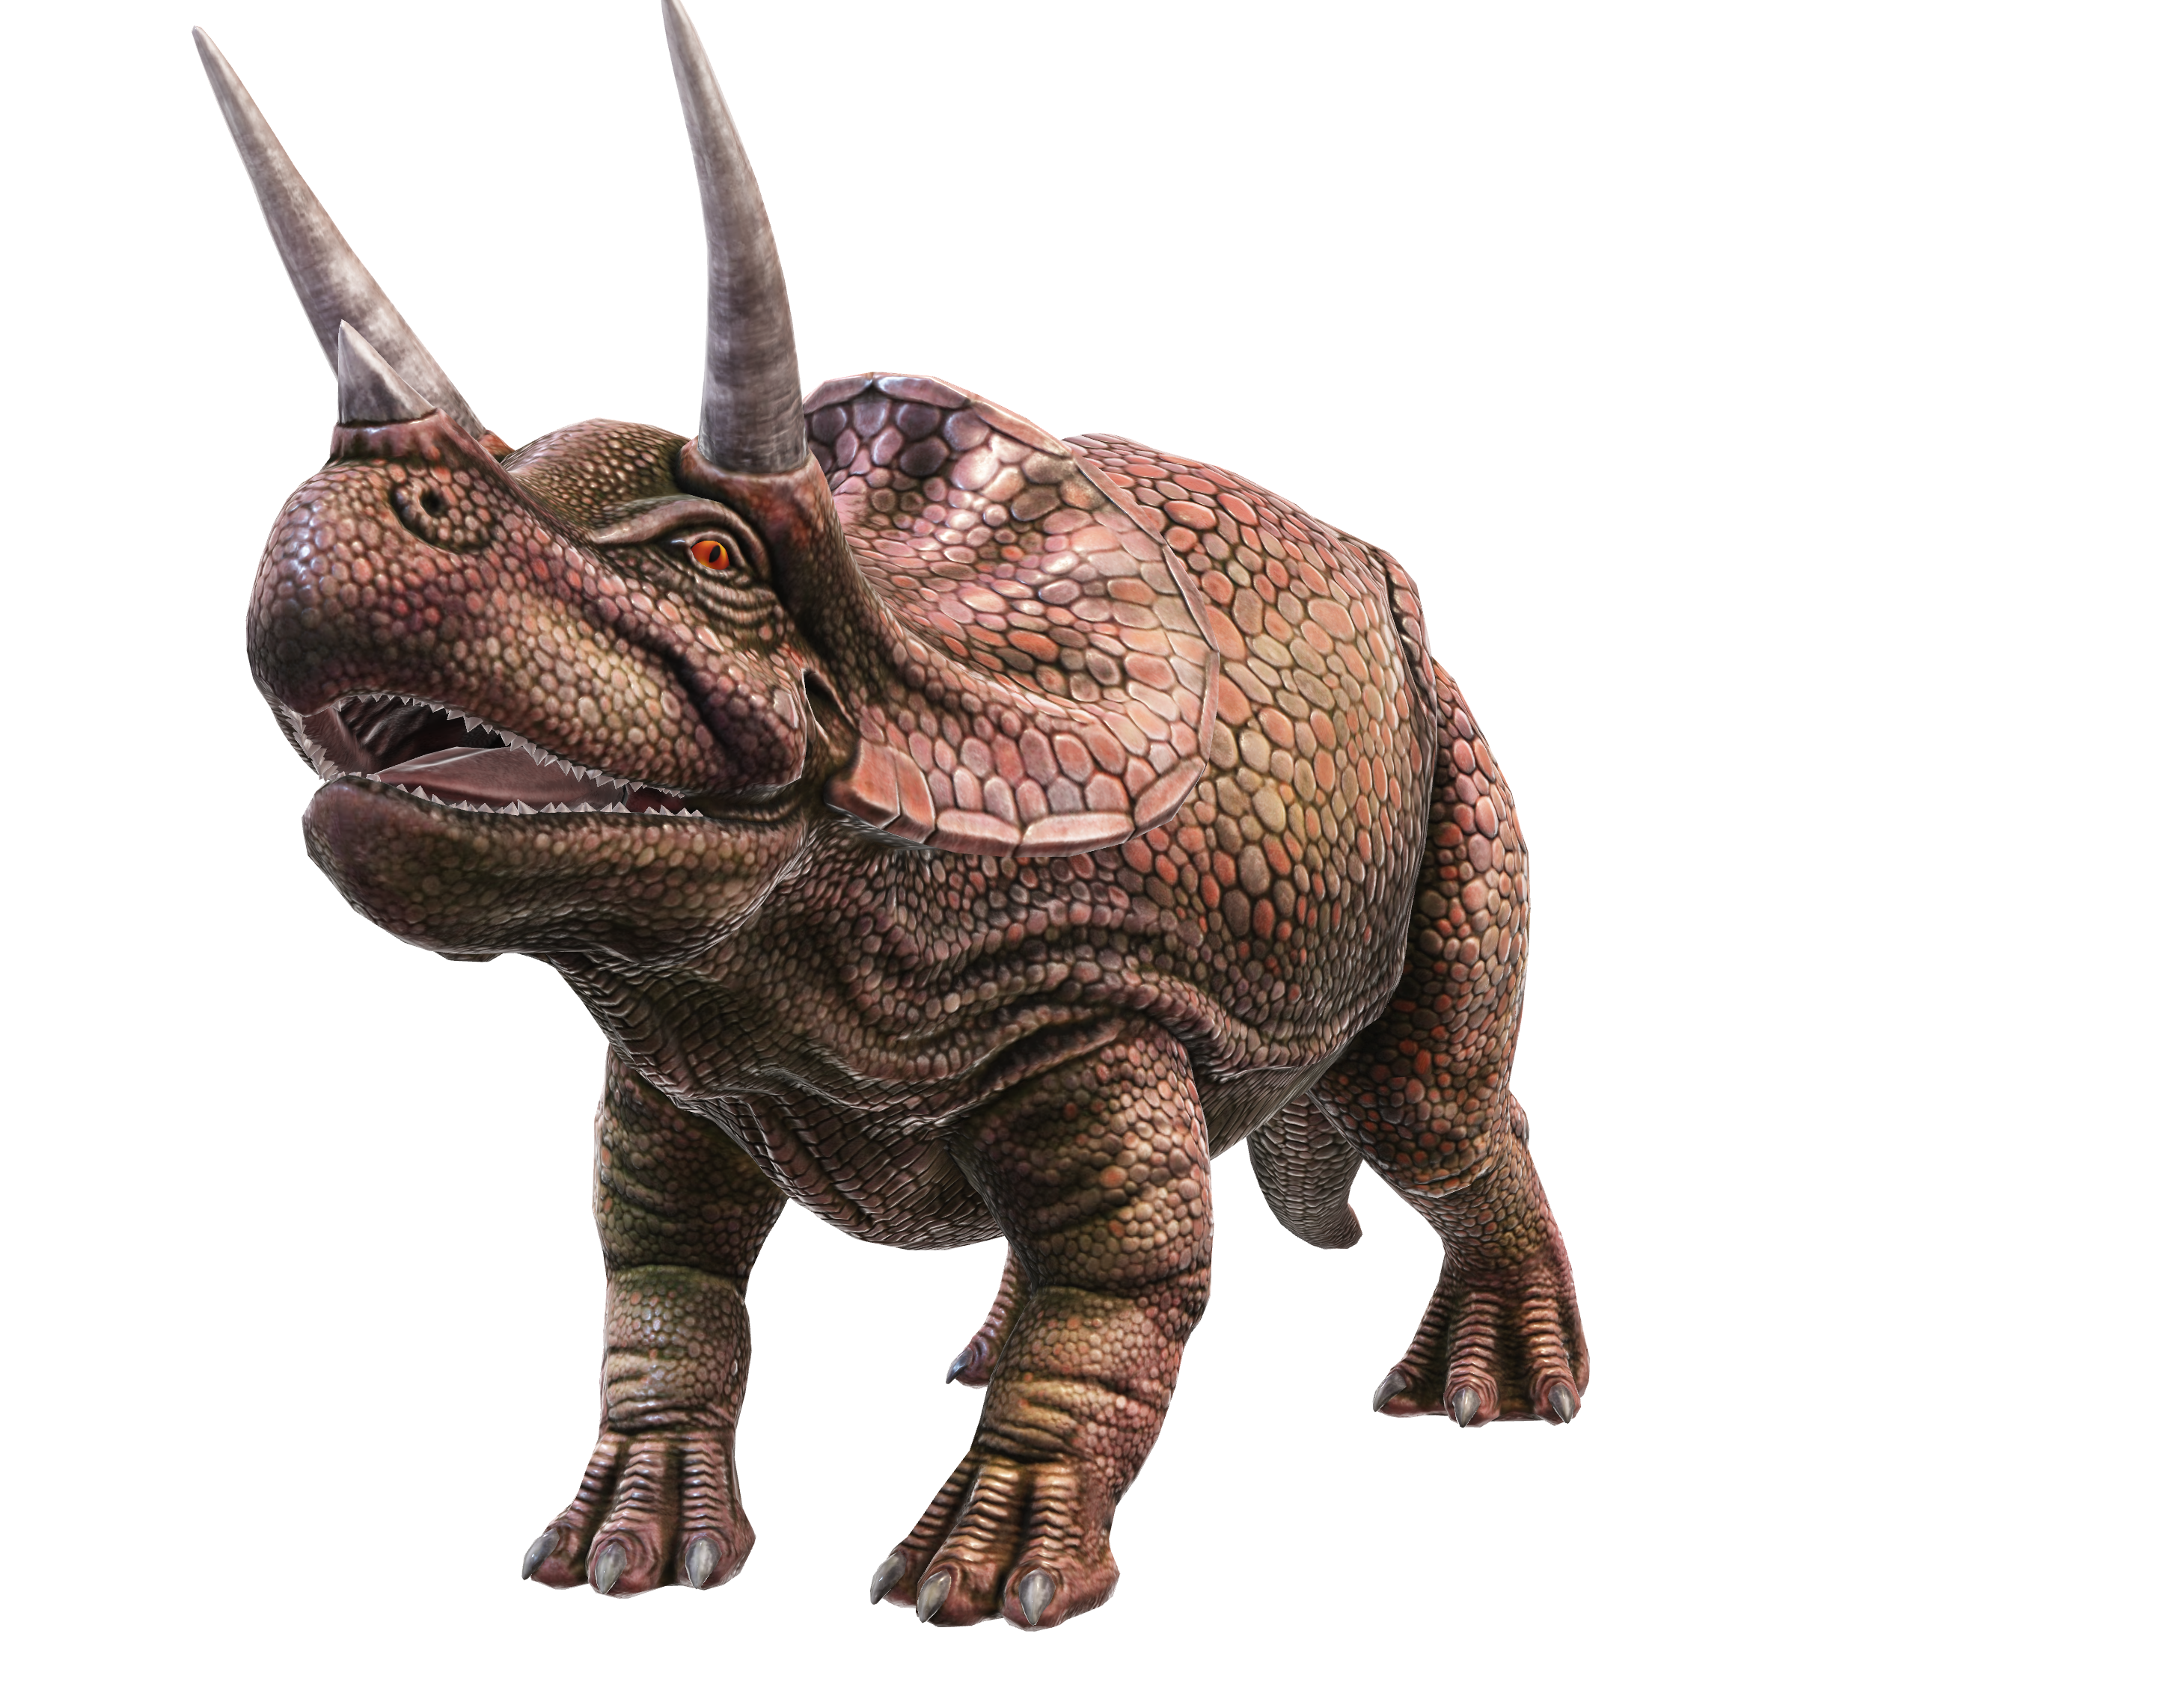
Dinosaurs Period
Dinosaurs lived in 3 periods
1)Triassic Period – 235 million years ago
2)Jurassic Period – 145 million years ago
3)Cretaceous Period – 66 million years ago

Slide 6
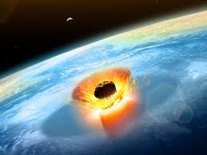
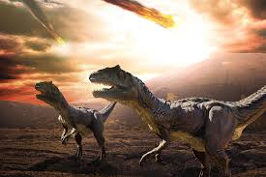
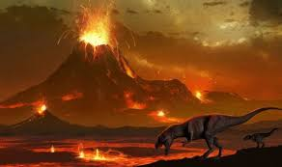
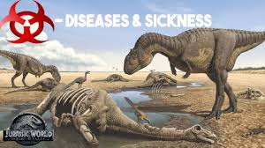
Dinosaur Extinction
1)Asteroid Collision
2)Volcano erupts
3)Climatic changes
4)Disease strokes

